Slide 1

Sentiment Analysis
with Movie Reviews
(NLP)
2015310884 철학과 박소현

Slide 2
Contents
1
Supervised Learning Method
- SVM, Random Forest
Unsupervised Learning Method
- k-means
2

Slide 3
1
Supervised Learning Method

Slide 4
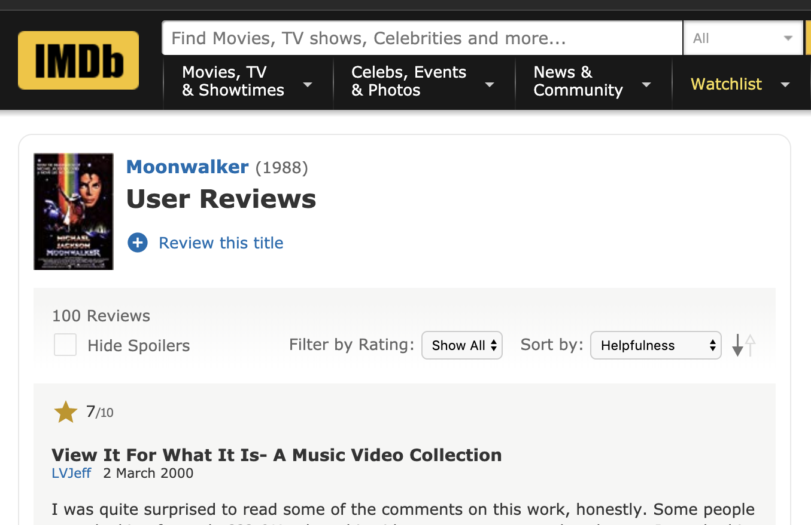
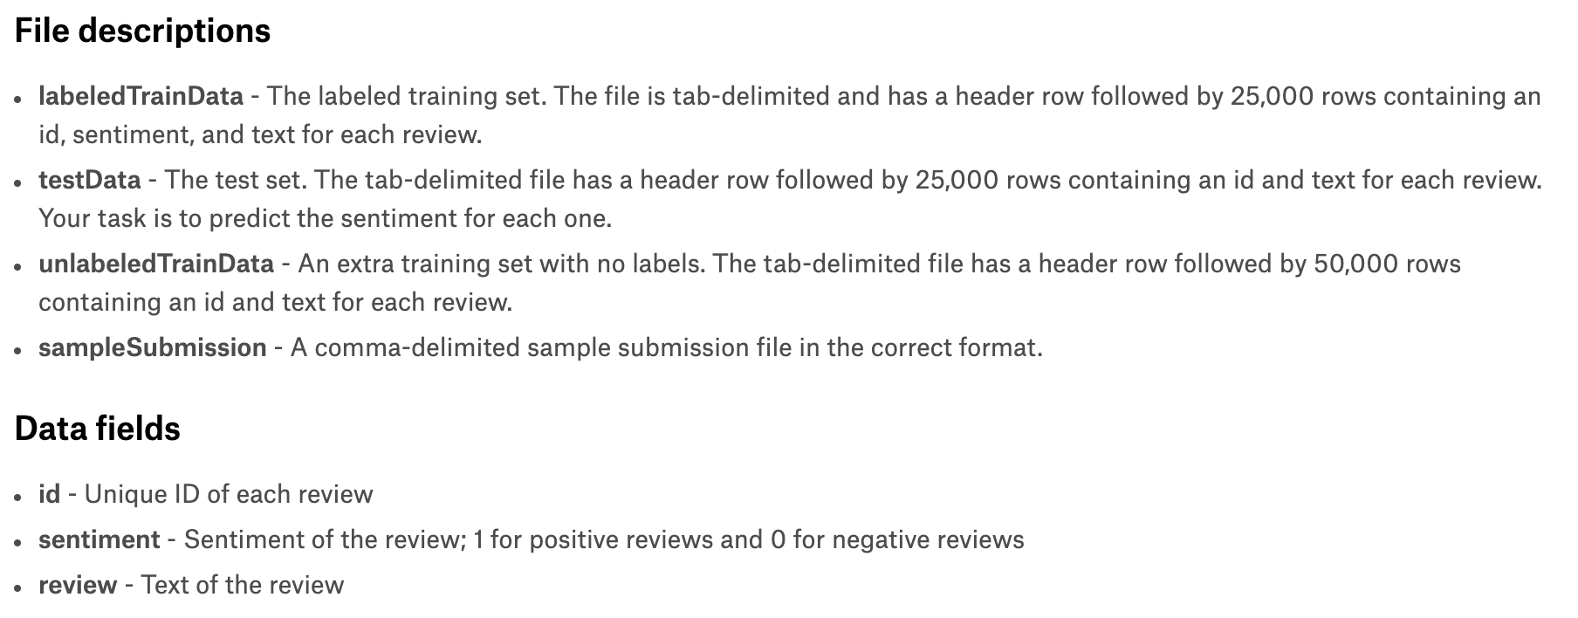
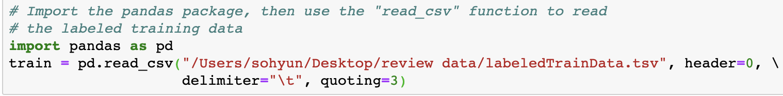
Data Explanation, Data Loading
- data set from kaggle
- data loading

Slide 5
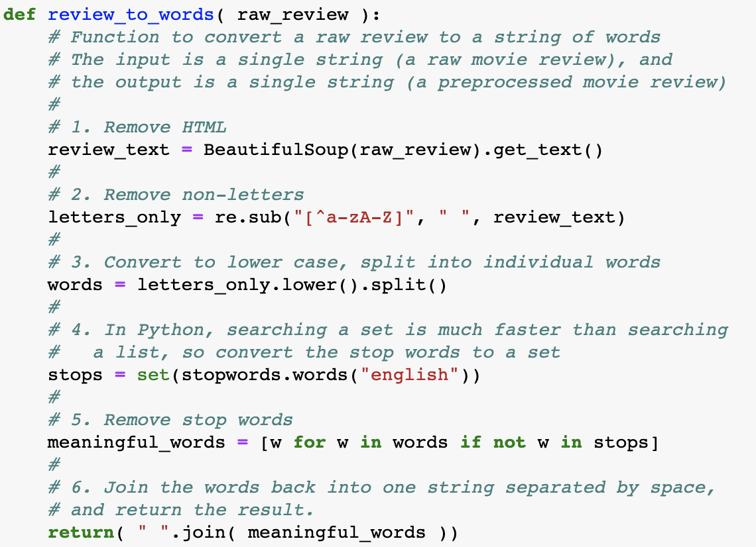
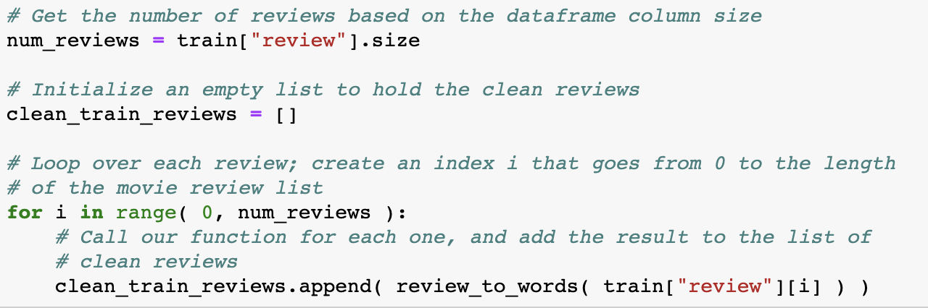
Data Processing
- data cleaning and text processing

Slide 6
Creating Features from a Bag of Words (Using scikit-learn)
(1) John likes to watch movies. Mary likes movies too.
(2) John also likes to watch football games.
[ "John", "likes", "to", "watch", "movies", "Mary", "too",
"also", "football", "games" ]
(1) [1, 2, 1, 1, 2, 1, 1, 0, 0, 0]
(2) [1, 1, 1, 1, 0, 0, 0, 1, 1, 1]
n-gram (n=2)
[ "John likes", "likes to", "to watch", "watch movies",
"Mary likes", "likes movies", "movies too", ]

Slide 7
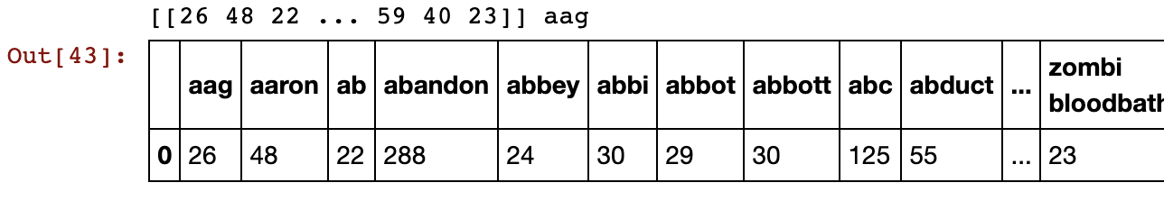
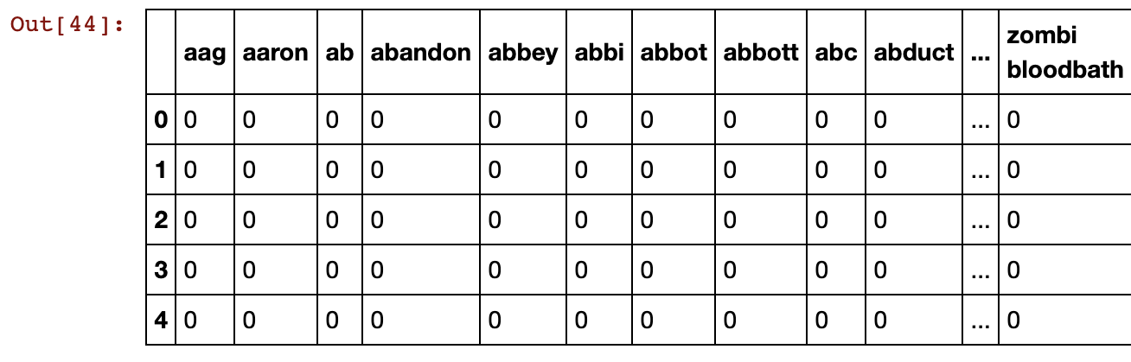
Creating Features from a Bag of Words (Using scikit-learn)
train_data_features

Slide 8
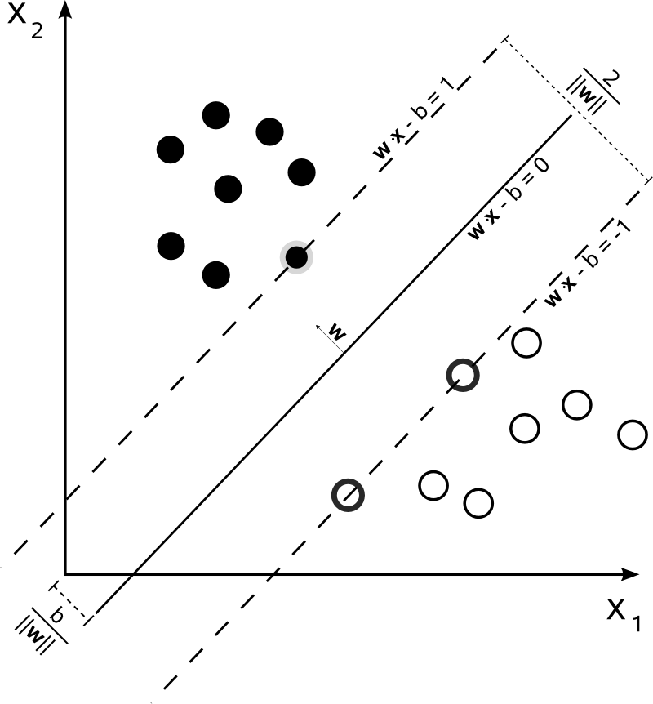
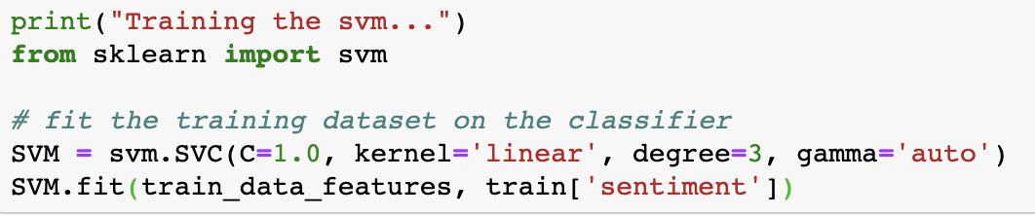
SVM Classifier
-> takes too much time
-> svm model is more suitable to small amount of data

Slide 9
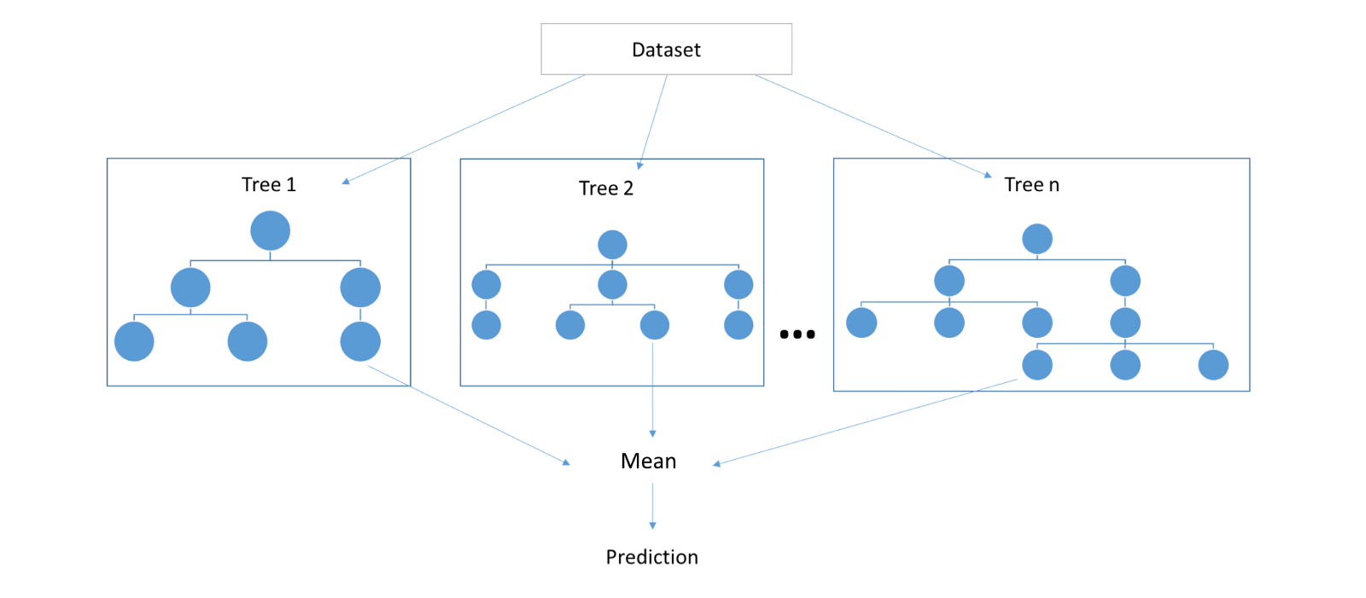
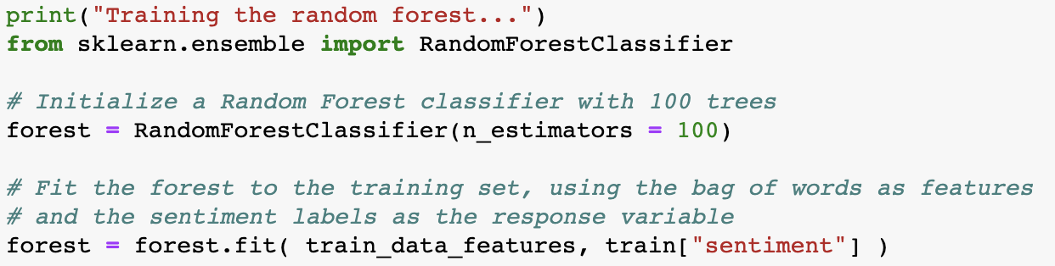
Random Forest Classifier

Slide 10
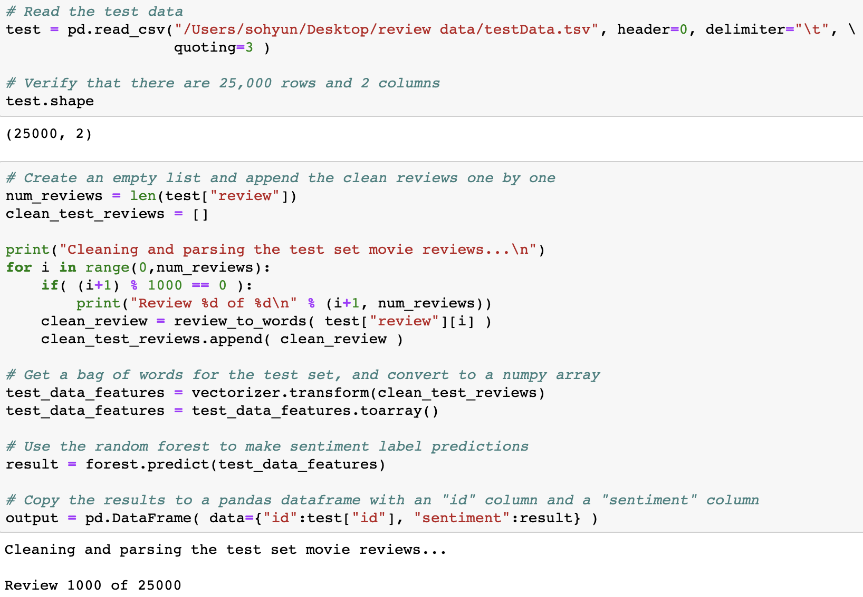
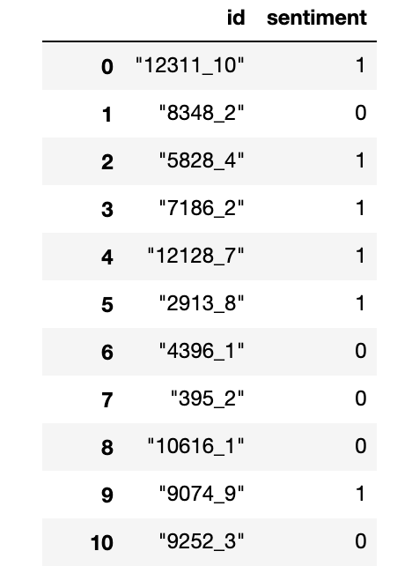

Prediction on Test
- code
- output
- score
...

Slide 11
2
Unsupervised Learning Method

Slide 12
Loading unlabeled_train data set
- data loading
- unlabeledTrainData.tsv -> doesn’t have ‘sentiment’ column

Slide 13
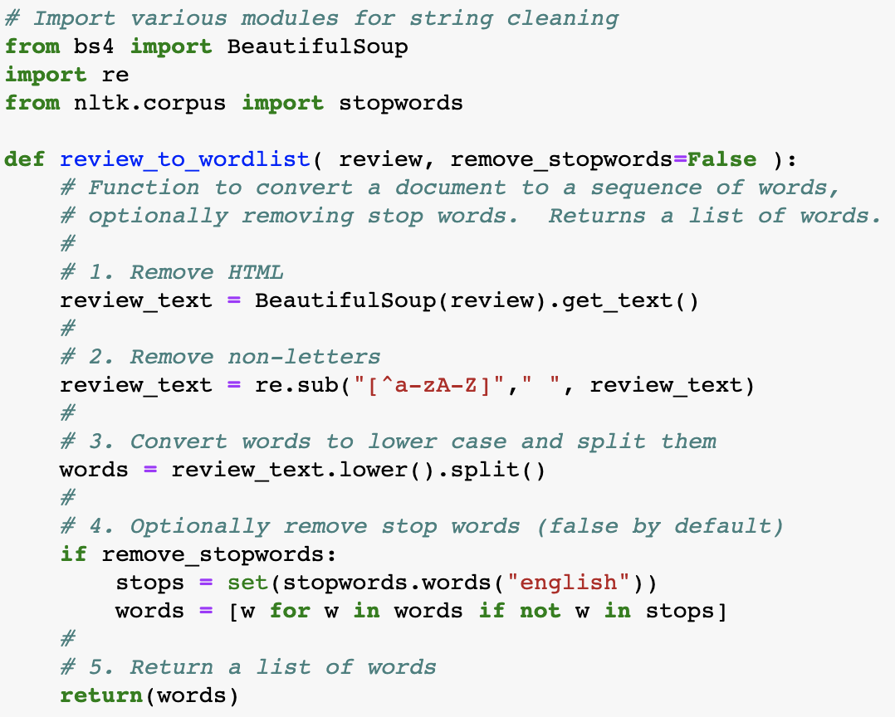
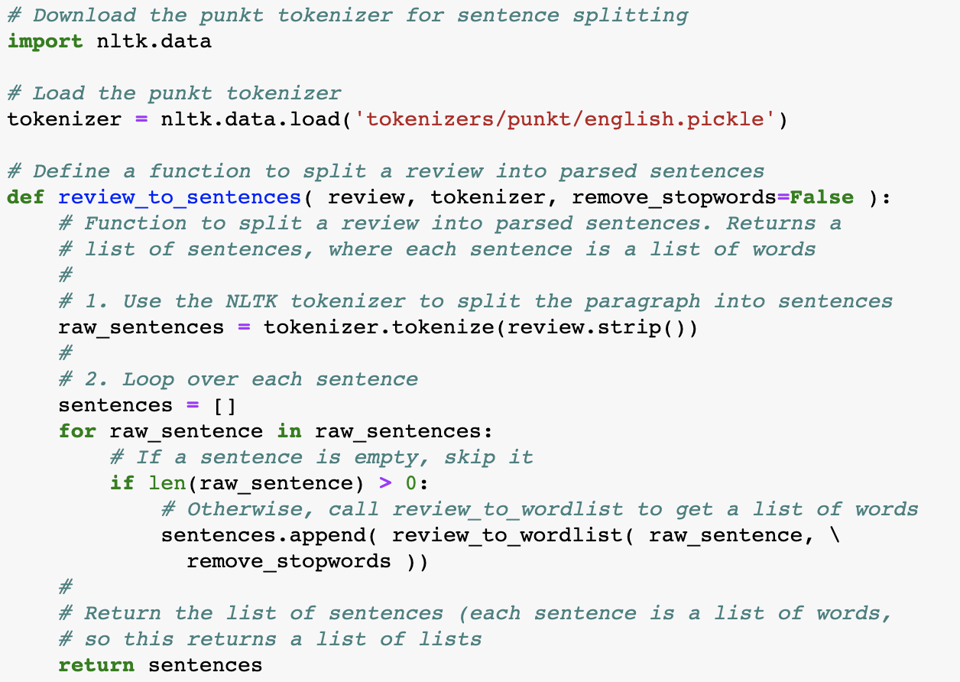
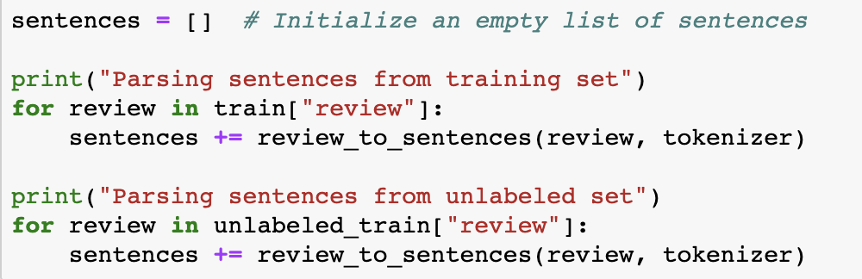
Data processing
- data processing

Slide 14
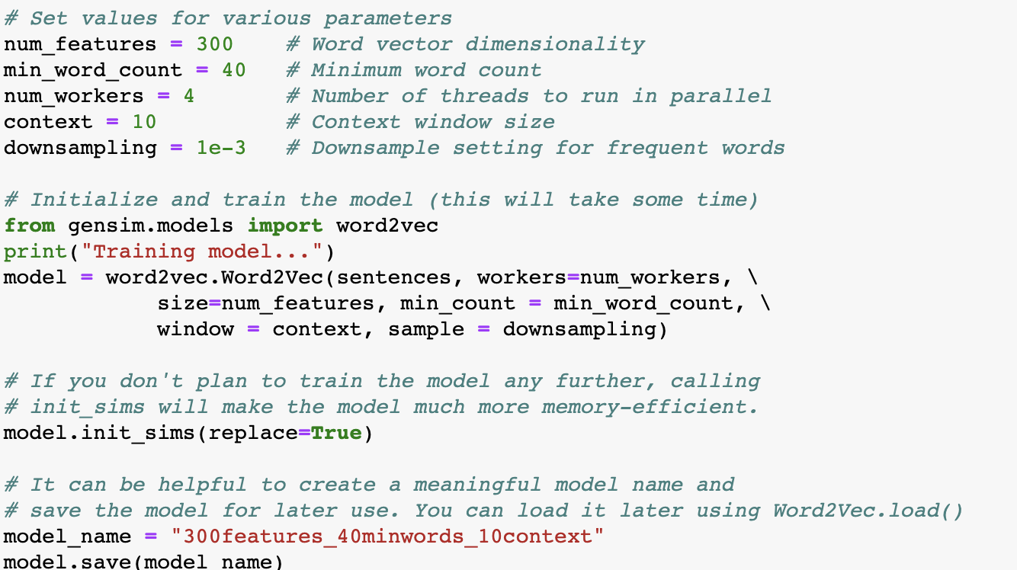
Creating features with Word2Vec
- Word2Vec
- It is not appropriate to use Bag of Word in unsupervised text learning,
because vector size is very big and sparse so performance is inefficient.
- It matches around with label.
- Word2Vec is used for sparsed text expressions and deduces similarity between words meaning.
- training and saving model

Slide 15
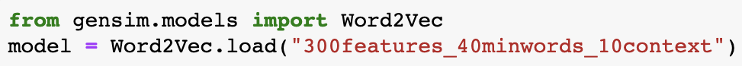
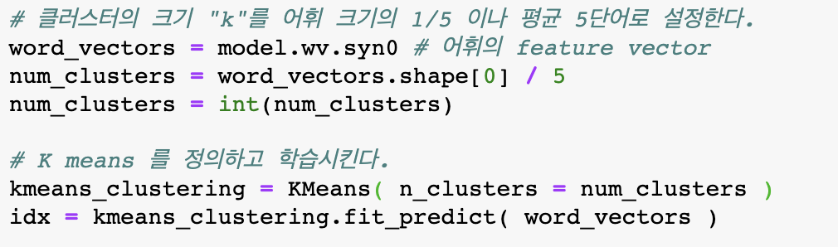
K-means Clustering
- load model
- clustering

Slide 16
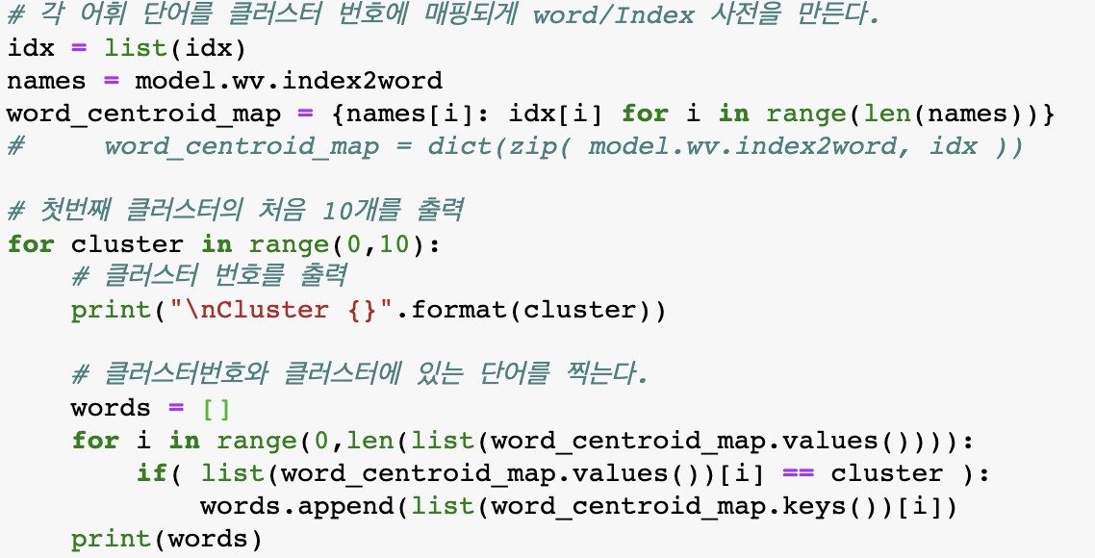
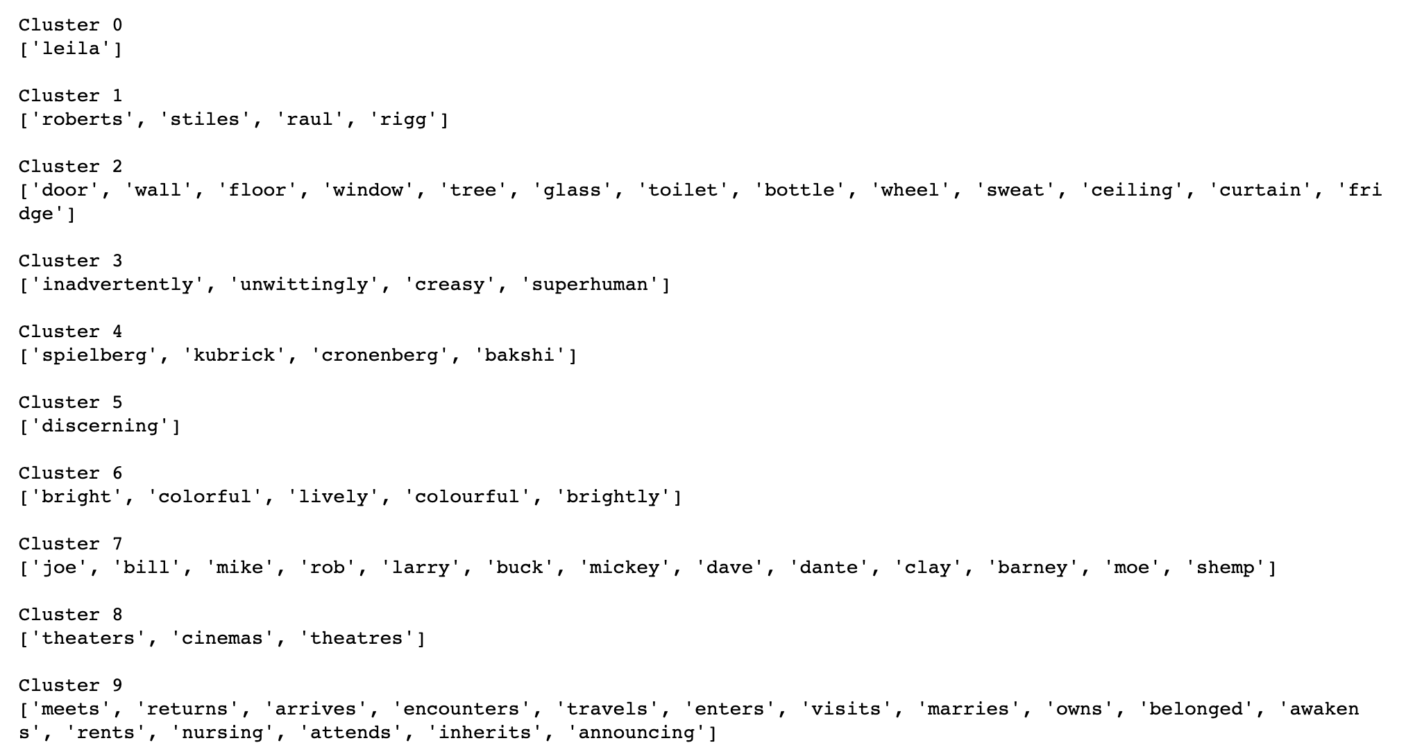
Clustering Result
- code
- output

Slide 17
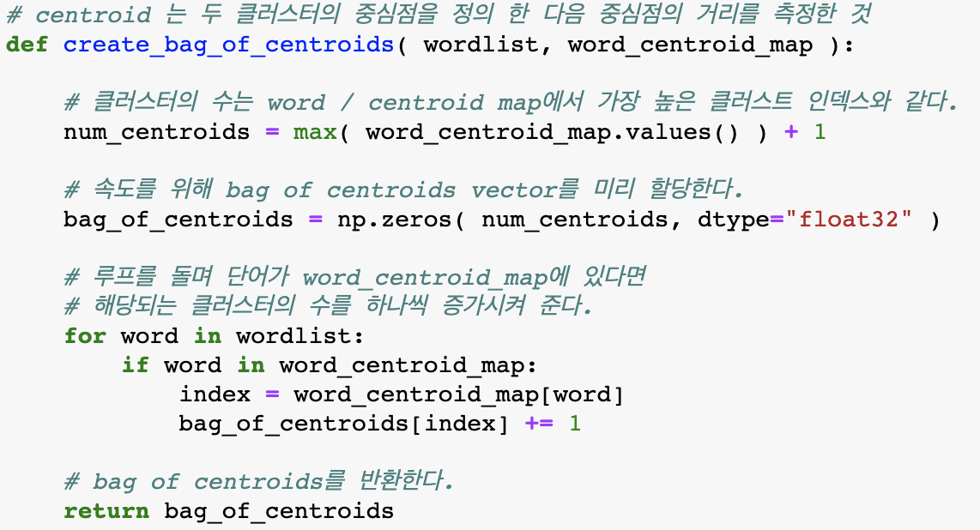
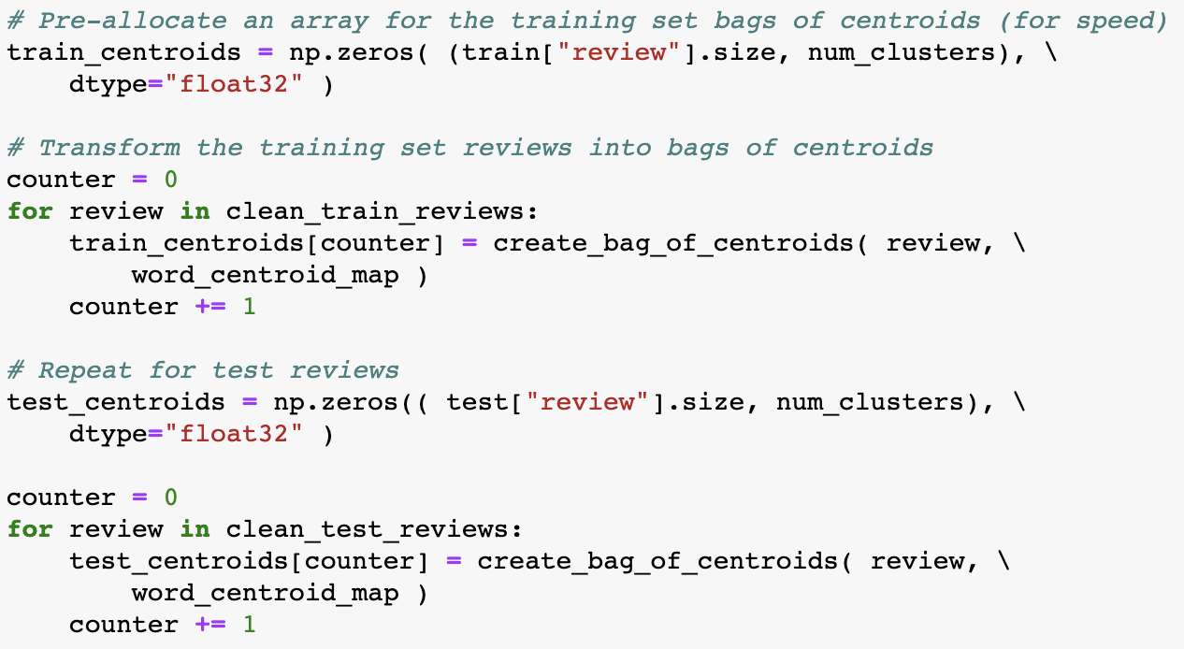
Bags of centroids
- transform the training set reviews into bags of centroids

Slide 18
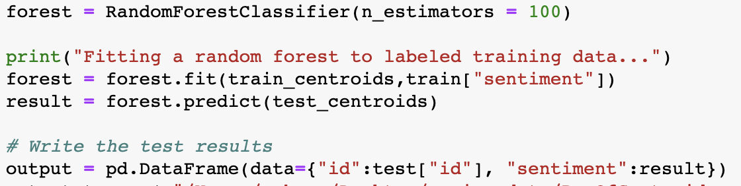
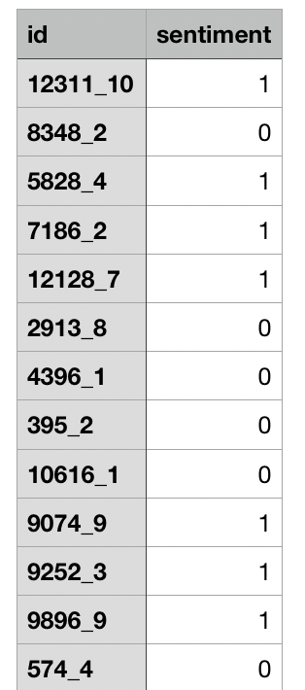

Fit a random forest and Prediction
- code
- output
- score
...

Slide 19
THANK YOU!

